Slide 1
Validation, Verification, and Testing of Computer Software
By : Rewan Ahmed Abd-Elsatar
Hadeer Yousry
Samar Alaa El-din yaqout

Slide 2
INTRODUCTION
The main attributes of software quality include reliability, testability, usability, efficiency, transportability, and maintainability.
Each software development project must determine which factors have priority and must specify their relative importance.
Two quality factors, reliability and testability, are tightly coupled with testing and verification issues.
Testable software must exhibit understandability and measurability.

Slide 3
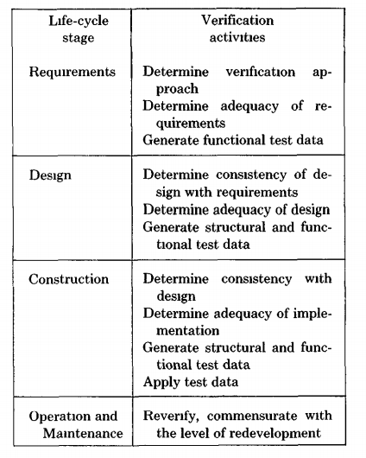
1. VERIFICATION THROUGH THE LIFE CYCLE
The success of performing verification throughout the development cycle depends upon the existence of a clearly defined and stated product at each development stage
The more formal and precise the statement of the development product, the more amenable it is to the analysis required to support verification.

Slide 4
1.1 The Requirements Definition Stage
A determination of the criticality of software quality attributes and the importance of validation should be made at this stage. Both product requirements and validation requirements should be established.
organization of the verification effort and test management activities should be initiated during the requirements stage, to be completed during preliminary design.
The test plan should identify test milestones and provide the testing schedule and requirements.
The test analysis report should summarize and document the test results and findings.
The analysis summary should present the software capabilities, deficiencies, and recommendations.

Slide 5
1.2 The Design Stage
During detailed design, validation support tools should be acquired or developed and the test procedures themselves should be produced.
Test data to exercise the functions introduced during the design process as well as test cases based upon the structure of the system should be generated.
Design inspection should be performed by the test team to discover missing cases, faulty logic, module interface mismatches, I/O assumptions, and user interface inadequacies.
Analysis techniques are used to show that the detailed design is internally consistent, complete, and consistent with the preliminary design and requirements.

Slide 6
1.3 The Construction Stage
Actual execution of the code with test data occurs during the construction stage of development.
Static analysis techniques detect errors by analyzing program characteristics such as data flow and language construct usage.
Dynamic analysis, performed as the code actually executes, is used to determine test coverage through various instrumentation techniques.
Formal verification or proof techniques may be used on selected code to provide further quality assurance.

Slide 7
bottom-up testing, an approach in which the lowest level of modules,are tested first and then combined for further testing with the modules that call them, the need for writing stubs can be eliminated. However, test drivers must still be constructed for bottom-up testing.
top-down testing, which starts with the executive module and incrementally adds modules that it calls, requires that stubs be created to simulate the actions of called modules that have not yet been incorporated into the system, but eliminates the need for drivers.
The testing order should be chosen to coordinate with the development methodology used.
1.4 The Operation and Maintenance Stage
Over 50 percent of the life-cycle costs of a software system are maintenance. As the system is used, it often requires modification either to correct errors or to augment its original capabilities.

Slide 8
2. VALIDATION, VERIFICATION, AND TESTING TECHNIQUES
2.1 Testing Fundamentals
The testing process is used to ensure that the program faithfully realizes the function & consists of obtaining a valid value from the functional domain. If the expected and the actual behavior agree, we say that the test instance has succeeded; otherwise, we say that the test instance has uncovered an error.
We can classify program test methods into dynamic analysis and static analysis techniques.
A complete verification of a program at any stage in the life cycle can be obtained by performing the test process for every element of the domain. If each instance succeeds, the program is verified; otherwise, an error has been found.
This testing method is known as exhaustive testing and is the only dynamic analysis technique that will guarantee the validity of a program

Slide 9
2.2 General Techniques
2 2.1 Tradlbonal Manual Methods
the most traditional means for analyzing a program is Desk checking, going over a program by hand while sitting at one's desk
Another method of increasing the overall quality of software production is peer review
2 2 2 Walk-Throughs, Inspections, and Reviews
Walk-throughs and inspections are formal manual techniques that are a natural evolution of desk checking, they are different in execution.but both require a team, usually directed by a moderator and including the software developer & based on a reading of the product
The difference between inspection and walkthrough lies in the conduct of the meeting.
Walk-throughs differ from inspections in that the programmer does not narrate a reading of the product by the team.

